Slide 1
Argument Assessment
CTE – Part 2

Slide 2

Summary so far
Arguments are where someone gives reasons (premises) to try to support some claim (conclusion)
Arguments are trying to find the truth
In bad arguments the premises do not really support the conclusion
There are two ways arguments can be bad
(a) Structure – the premises do not lead to the conclusion. They do not connect the right way to the conclusion
(b) One of the premises is false
There are two kinds of argument that people use
(a) Deductive arguments – the structure is trying to be: conclusion MUST be true if premises are true
(b) Inductive arguments – structure is trying to be: conclusion is PROBABLY true if the premises are true

Slide 3
The words good and bad are a bit too vague. We need more accurate language to describe arguments.
We need to talk more about good and bad arguments and learn some more technical vocabulary. The basic concepts we will look at are:
Validity – good structure for deductive arguments
Force – good structure for inductive arguments
Soundness – good structure AND true premises
Sound can be used to describe both deductive and inductive arguments.

Slide 4
To make it easier to evaluate the structure of an argument we needs to:
1) Make the structure of an argument as clear as possible
2) Understand what makes premises true or false
We can make it easier to do this by:
1) Presenting arguments in 'Standard Form'
2) Understanding the 'Logical Form' of arguments

Slide 5
Standard Form
Arguments can be simple or complex, long or short. Sometimes it is useful to use a system called standard form to make them clear.
We list the premise(s) first and number them in the correct order P1, P2, P3, Pn, etc. and finally we list the conclusion at the end and label it with C.
You should eat more oranges, because they are a good source of vitamin C.
P1: Oranges are a good source of Vitamin C.
C: You should eat more of them.

Slide 6
Standard Form Examples
P1) John is tall.
P2) Tall people are good at basketball.
C) John is good at basketball.
The line before the conclusion is called an inference bar.

Slide 7
Standard Form Practice 1
Zhuhai is in China in virtue of the fact that Zhuhai is in Guangdong and Guangdong is in China.
P1: Zhuhai is in Guangdong.
P2: Guangdong is in China.
________________________________
C: Zhuhai is in China.
When writing an argument in standard form, it is important to remove the argument indicators as they do not contribute to the argument itself.

Slide 8
Standard Form Practice 2
Translate the following argument into standard form (note: you may need to alter the language):
Computer games have many positives, which is why, overall, I believe they are good for you. I can name at least two: first they have been proven to improve reading and literacy skills, and second research suggests that they have a beneficial effect on hand-eye coordination.

Slide 9
Answer
P1: Computer games have been proven to improve reading and literacy skills.
P2: They have a beneficial effect on hand eye coordination
___________________________________________________________________C: Computer games are good for people.
We need to remove any unnecessary information that does not contribute to the argument itself. As we list P1 first, it’s important to use the proper noun. We can then use pronouns in further premises if it is clear what they are referring back to.

Slide 10
Standard Form Practice 3
Whilst I understand that it is easier to administer 1 final exam, it puts a lot of pressure on students, and does not give students the best opportunity to demonstrate their ability. So I think final exams are a bad idea.
P1: Final exams put a lot of pressure on students.
P2: They do not give students the best opportunity to demonstrate their ability.
_________________________________________________________C: Final exams are a bad idea.
Remove any concessions or counter examples as they do not contribute to the argument being made.

Slide 11
When we think about the structure of an argument it does not matter what the premises or conclusion are actually saying
We can see the structure of an argument more easily if we look at its logical form

Slide 12
Representing Logical Form
We can make the form of arguments clearer by replacing names, general terms and sentences with letters
P1) Matthew is a man
P2) All men need air to live
--------
C) Matthew needs air to live
P1) x is an F
P2) All F are G
-----------------------
C) x is a G

Slide 13
P1) If it is raining then there are clouds in the sky
P2) There are clouds in the sky
_________________
C) It is raining
P1) If A then B
P2) B
___________
C) A

Slide 14
P1) Most people are afraid of dying
P2) Paul is a person
_____________
C) Paul is afraid of dying
P1) Most As are Bs
P2) x is an A
________________
C) X is a B

Slide 15
Good structure for deductive arguments: Validity
P1) Matthew is a man
P2) All men have three legs
----------------------------------
C) Matthew has three legs
P1) Paul needs air to live
P2) All men need air to live
-----------------------------------
C) Paul is a man

Slide 16
Validity
You can see that the structure of the first argument is a good one, while the structure of the second one is bad
This has nothing to do with the truth of the premises or the conclusions. Important: Structure is independent of the truth of the premises or conclusion
The conclusion of the first follows from the premises, while the conclusion of the second does not. The premises in the first argument lead to the conclusion
The premises of the first argument lead to the conclusion in this way: If the premises are all true, then the conclusion HAS to be true
We say the first argument is valid while the second is invalid

Slide 17
Validity
validity:
An argument is valid when:
If the premises are/were true, the conclusion would also have to be true
It would be impossible for all of the premises of the argument to be true, and the conclusion false
(These mean the same)

Slide 18
Validity
Validity is a property of arguments
Truth or falsity are properties of statements/propositions
Propositions/statements cannot be valid or invalid
Arguments cannot be true or false
Valid ≠ Good,
Some valid arguments are bad arguments
Valid ≠ True, Invalid ≠ False
Only propositions are true or false, arguments are not true or false.

Slide 19
Validity IV
Invalid Example
P1: Almost everyone in China likes tea. T
P2: Mr Chen is from China. T
C: Therefore, Mr Chen likes tea.
What logically possible situation makes this argument not valid?

Slide 20
Validity V
Valid Example
P1: Zhuhai is in Guangdong.
P2: Guangdong is in China.
C: Therefore, Zhuhai is in China.
What logically possible situation makes this argument valid?

Slide 21
Validity VI
Is this valid/invalid/not valid? Explain your answer.
P1: Many fruits are a good source of vitamin C.
P2: Bananas are fruits.
C: Therefore, bananas are good sources of vitamin C.

Slide 22
Valid forms of argument
Here are some valid forms of argument ( it doesn’t matter what sentences/names/kinds we put in)
P1) A or B
P2) Not A
---------------
C) B

Slide 23
Valid forms of argument
P1) If A then B
P2) A
-------------------
C) B

Slide 24
Valid Forms of Argument
P1) If A then B
P2) Not B
______
C) Not A

Slide 25
Valid Forms of Argument
P1) All F are G
P2) x is F
---------------------
C) x is G

Slide 26
Assessing arguments for validity
How to judge validity
Try to think of a situation where the premises are all true and the conclusion false
This situation is called a counterexample
If it is impossible to do this, then the argument is valid. If it is possible to do this, then the argument is invalid.

Slide 27
P1) Matthew needs air to live (True)
P2) All men need air to live (True)
----------------------
C) Matthew is a man (True)
A very simple counterexample to this would be the situation where Matthew is a woman. IF this is true, then premise 1 is true, premise 2 is true and the conclusion is false
This proves the argument is invalid
But ANY example of an argument with the same logical form as this argument where the premises are true and the conclusion is false would also be a counterexample

Slide 28
Representing logical form
P1) Lady GaGa needs air to live (x is a G)
P2) All men need air to live (All Fs are Gs)
---------------------------
C) Lady GaGa is a man [x is an F]
This is called ‘refutation by counterexample.’

Slide 29
Summary
The good structure for deductive arguments is validity
An argument is valid when: if all the premises are true this means the conclusion has to be true as well
We can prove an argument is invalid by thinking of a counterexample (refutation by counterexample)
A counterexample is an example of an argument where all the premises are true and the conclusion is false
If an argument has no counterexample, if it is IMPOSSIBLE to think of a counterexample, then it is valid

Slide 30
Good structure for inductive arguments: Force
Remember that human beings use deductive and inductive arguments
P1) My neighbor’s dog has barked every morning
______
C) So it will bark this morning
This is obviously a pretty good argument, and we use arguments like this all the time. But it is invalid. Even if the premise is true, the conclusion could still be false
So what should we say? It is obviously a good argument, but it is not valid. But that doesn’t matter. This argument is not a deductive argument – it is an inductive argument.

Slide 31
In a deductive argument someone is trying to use reasons to make you think that something must be true
In an inductive argument someone is trying to use reasons to make you think that something is probably true
In the previous argument, someone is trying to support the claim that their neighbours dog will probably bark this morning. They are not trying to support the claim that, logically, it must bark this morning

Slide 32
Inductive force
So validity is not important for inductive arguments – instead, what is important is force
To say that an argument is forceful is to say:
If the premises are/were true, then, given no more information than that contained in the premises, it would be more reasonable to expect the conclusion to be true than to expect it to be false (the conclusion is probably true)

Slide 33
Force comes in degrees
Arguments can be more or less inductively forceful
P1) 15 out of 29 children in the class are wearing white socks
------------------------
C) The child who scored the highest in the spelling test is wearing white socks
This argument is forceful, but only barely
Answer question 1 on the worksheet:

Slide 34
Summary
The good structure for inductive arguments is force
An argument is forceful when: If all the premises of the argument are true, this means the conclusion is probably true
We will see later that this isn’t always so easy to calculate

Slide 35
Notice that ALL inductive arguments are invalid, even if they have force. This is part of the nature of inductive arguments – they go ‘beyond’ the premises
But this does not matter. If an argument has force, the premises lead to the conclusion, and so a forceful argument has a good structure

Slide 36
Soundness
If an argument is valid or forceful then it has a good structure – the premises lead us to the conclusion
But this doesn’t mean the argument is a good one. There are two ways an argument can be bad – it can have the wrong structure or have false premises

Slide 37
An argument is sound when it has a good structure AND all the premises are true
To be more precise:
An argument is sound when either
It is valid and all the premises are true (To keep things clear we will call this deductive soundness)
It is forceful and all the premises are true (To keep things clear we will call this inductive soundness)
Good arguments are sound arguments

Slide 38
With lots of statements it is very easy to realise what we need to prove, in order to prove that the statement is false
Most As are Bs
You can prove that this is false by proving that at least over 50% of As are not Bs
x is an F
You can prove that this is false by proving that x is not an F

Slide 39
If A then B (conditional)
This is false if A is true and B false. You can prove that it is false by thinking of an example where A is true and B is false. Note that this is the only way to prove that it is false.
For example:
‘If there are clouds then it is raining’
You can prove that this is false by giving examples where ‘there are clouds’ is true and ‘it is raining’ is false.
You cannot prove that it is false by giving examples when there are clouds and there is rain, or no clouds and rain, or no clouds and no rain

Slide 40
‘A only if B’ = ‘If A, then B’
‘John passed the exam only if he studied hard’, means the same as ‘If John passed the exam, then he studied hard’
‘A if B’ = ‘If B, then A’
‘John passed the exam if he studied hard’ means the same as ‘If John studied hard, then he passed the exam’
‘A unless B’ = ‘If not B, then A’
‘John did not pass the exam unless he studied hard’ means the same as ‘If John did not study hard, then he did not pass the exam’

Slide 41
A and B (conjunction)
This is false if either of these are false. You can prove that this is false by proving that A is false, by proving that B is false, or by proving that they are both false
For example
‘Matthew is a teacher and Matthew is the President of the United States’ is false because ‘Matthew is the President of the United States’ is false

Slide 42
A or B (disjunction)
This is false if both of these are false. You can prove that this is false by proving that they are both false
For example
Matthew is a teacher or a man is true, because both of these are true
Matthew is a woman or a soldier is false, because neither of these are true

Slide 43
‘A or B’ is ambiguous between exclusive ‘or’, which means ‘one of these is true but not both of these’ and inclusive ‘or’, which means ‘at least one of these is true’.
To remove this ambiguity, whenever we use ‘or’ in critical thinking, we mean inclusive ‘or’. If we want to express ‘exclusive or’ we will say ‘A or B, but not both’
So ‘A or B’ is false only when A and B are both false. If they are both true, it is still true.

Slide 44
A if and only if B (biconditional)
This means ‘If A then B’ and ‘If B then A’
You can prove that this is false by proving that A can be true without B being true, or by proving that B can be true without A being true
For example
‘Matthew is a teacher if and only if he works in an educational setting’ is false. This is because it is false that if Matthew works in a educational setting, then he is a teacher. He could be a janitor at a school, for example.

Slide 45
Not A (negation)
You can prove that this is false by proving that A is true

Slide 46
All Fs are Gs
You can prove that this is false by proving that at least one F is not a G

Slide 47
Say if you think these statements are true or false. Say why.
Anyone who is at UIC is a student
If someone is married, then they have a ring
If Matthew drinks 10 litres of whisky in 5 minutes, he will die
You won’t pass unless you study hard
Matthew is not a woman
Donald Trump is an idiot and English
Donald Trump is an idiot or English
Donald Trump is an idiot or American
Most people don’t like pain
Matthew is either rich or poor
No-one hates the Avenger movies
You will pass the critical thinking class only if your final grade is over 20%

Slide 48
Which of the following statements are true, and which false? Where it is possible, give an example
valid arguments can have a false conclusion
Deductively sound arguments can have a false conclusion
forceful arguments can have a false conclusion
Inductively sound arguments can have a false conclusion
deductively unsound arguments can have a true conclusion
inductively unsound arguments can have a true conclusion

Slide 49
Types of Argument
Let’s return to types of arguments, so we can see their structure. We will introduce 4 common types of argument:
Deductively Valid.
Induction based on statistics.
Induction based on analogy.
Induction based on inference to best explanation.

Slide 50
What is ‘Deduction’?
If an argument is ‘deductively valid’ we can be logically certain that the conclusion is true, if the premises are true.
All men are mortal.
Socrates is a man.
Therefore, Socrates is mortal.
Deductive validity is the strongest type of argument.

Slide 51
Deductively Valid
If the premises are true, then the conclusion MUST be true also.
P1) Everyone is good at basketball. T
P2) Everyone is good at football. T
C) Therefore, John is good at basketball and football.

Slide 52
Induction based on statistics
Often we use statistics to support our claims. The statistics can make our arguments inductively strong.
P1) 90% of men enjoy sport. T
P2) 95% of people that enjoy sport enjoy football. T
C) Therefore, John enjoys football.
Of course, the strength of the argument depends on the statistics.

Slide 53



What do the following statistics represent?
What conclusions might people draw from them?

Slide 54
Induction based on analogy
Some time we make an analogy between two things to defend our argument.
P1) Poison X is harmful to rats. T
P2) Poison X is also harmful to Chimpanzees. T
C) Therefore, poison X is harmful to humans.
Of course, the strength of the argument depends on quality of the analogy.

Slide 55
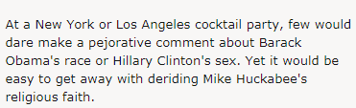

Slide 56
Induction based on inference to best explanation
Sometimes there is more than one explanation for a premise, but we choose the best one.
P1) The road is wet this morning. T
P2) The roofs of the houses are also wet. T
C) Therefore, it must have rained last night.
Of course, it is possible that someone washed the road…. But the wet roofs suggests rain.

Slide 57


Slide 58

For each of the following examples, work out what the mistake(s) are:
Inductive arguments cannot be valid.

Slide 59
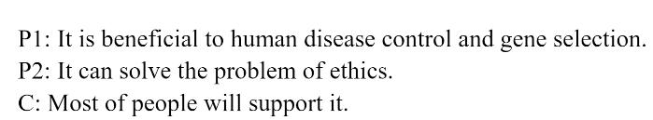
Unclear use of pronouns. In standard form pronouns can only be used if they refer back to a proper noun which has appeared in a previous proposition.

Slide 60
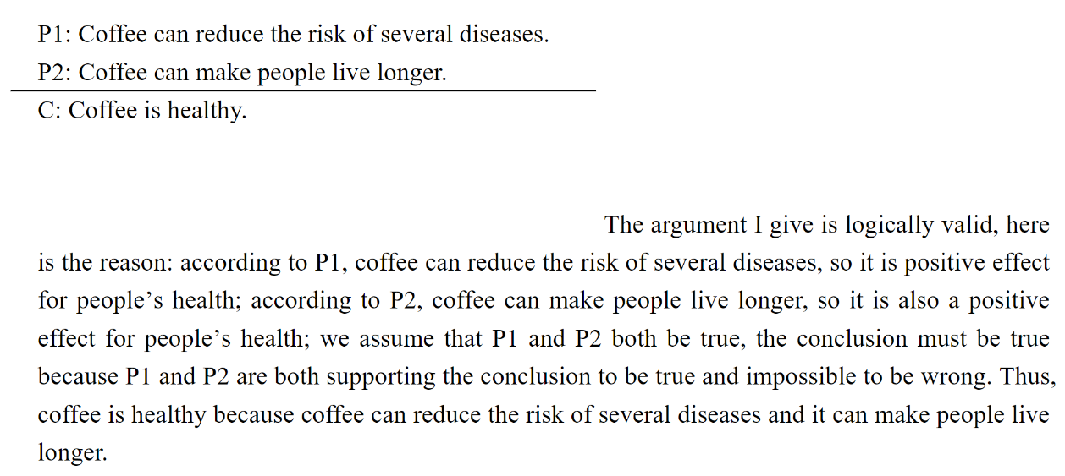
The argument is not logically (deductively) valid. Healthy is too broad a term to be fully covered by 'live longer' and 'reduce the risk of several diseases'. It is possible that coffee could increase the risk of several other diseases, or simply be unhealthy for people who already have certain diseases. So it is possible for the premises to both be true and the conclusion to be false.

Slide 61
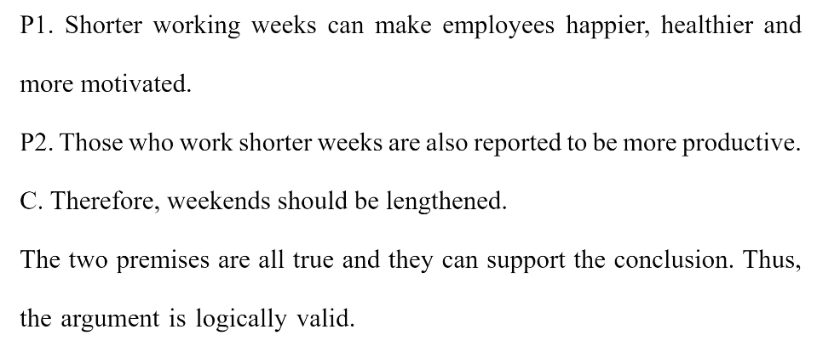
The argument is not logically (deductively) valid. In valid arguments the conclusion cannot go beyond the premises. As the premises do not contain ‘should’ the conclusion cannot either. More obviously, the premises do not create a situation where it is impossible for them to be true and the conclusion false.

Slide 62
Arguments cannot be both deductive and inductive. Arguments that are based on inference to best explanation are always inductive.

Slide 63
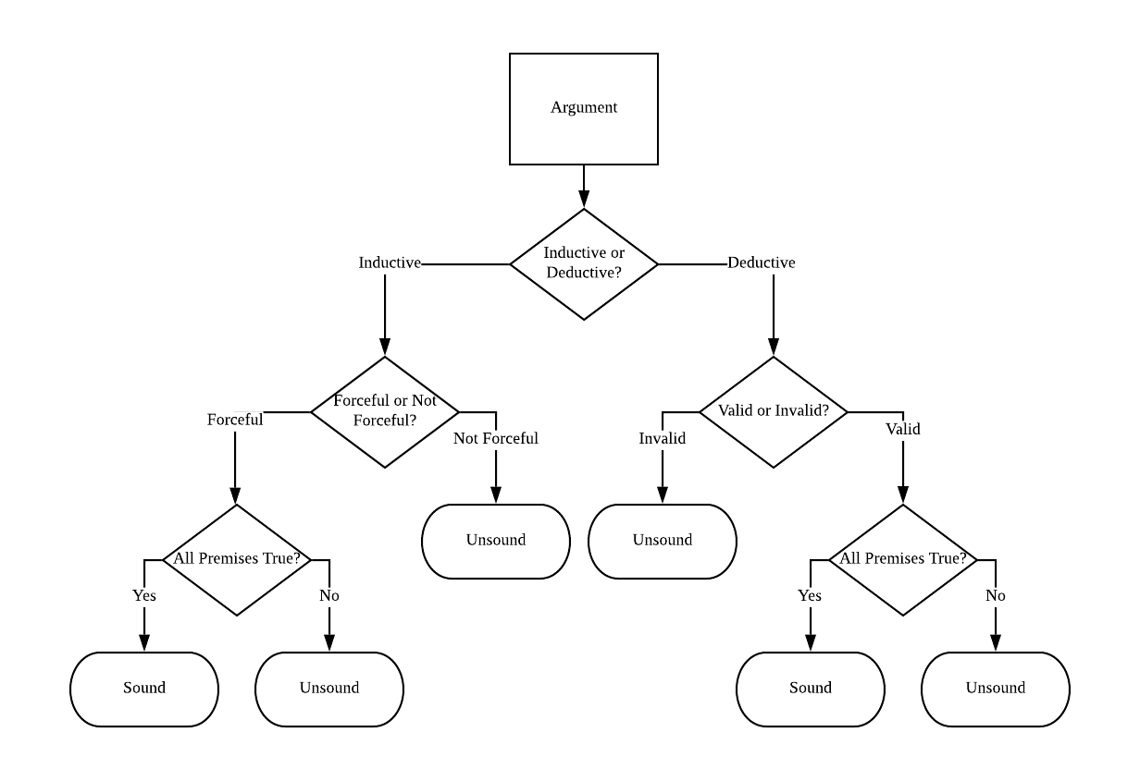

Slide 64
Exercise: Tell me if this argument is sound or not. Give me your reasons.
P1) If abortion is not murder, then infanticide is not murder
P2) If infanticide is not murder, then killing innocent children is not murder
P3) Killing innocent children is murder
-----------------------------
C) Abortion is murder

